Slide 1

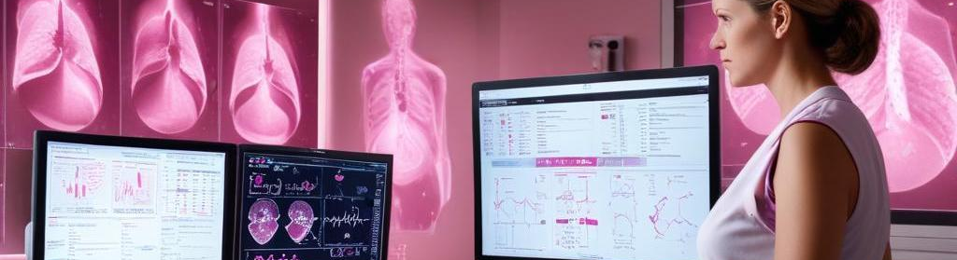
Breast Cancer Detection
Using Machine Learning
JAISH NAWED - 22052731
MOHAMMAD AAS KHAN- 22052561
NASER AHMAD - 22052741
SNIGHDHA - 22052680
ISHU KANT - 22052730
MOHAMMAD KAIF - 22051261

Slide 2
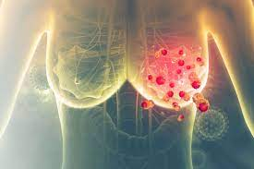
Introduction
Breast cancer remains a major health concern for women globally. Early detection significantly boosts survival rates and treatment success.
This project proposes an MI-driven diagnostic solution that combines deep learning and traditional machine learning through a user-friendly web application.
By simply entering clinical data, users can receive real-time predictions on breast cancer presence.

Slide 3
Project Architecture
Breast cancer remains a critical health concern, representing a significant share of cancer-related mortality among women globally. Early detection is vital, as it dramatically increases treatment success rates and patient survival. In response, this project presents a robust and intelligent system designed for rapid and accurate breast cancer prediction.
Frontend (User Interface):Built using HTML and CSS, the frontend offers a clean, responsive, and intuitive interface where users can seamlessly input clinical data.
Backend (Server Logic):Developed with Python and Flask, the backend acts as the control center—managing input from the frontend, interfacing with trained models, and delivering real-time predictions to the user.
Machine Learning Models (Prediction Engine): The core predictive engine consists of two models:
DenseNet128 Deep Learning Model: A custom neural network designed for high-accuracy classification.
Enhanced Random Forest Classifier: A traditional ensemble model used for performance benchmarking and reliable comparison.

Slide 4
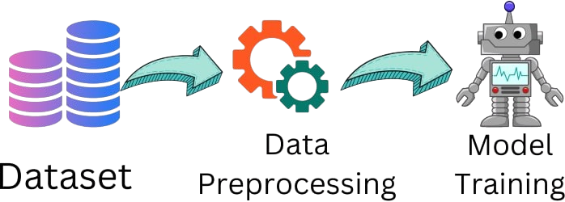
Dataset and Preprocessing
High-quality dataset preparation is crucial for reliable prediction.
The following preprocessing steps were conducted:
Data Cleaning – Removing missing or inconsistent values.
Normalization – Scaling features for consistency.
Feature Selection – Retaining significant attributes.
Data Splitting – Training and test data generation.
Storage – Saved in '.py' format for speed and ease.

Slide 5
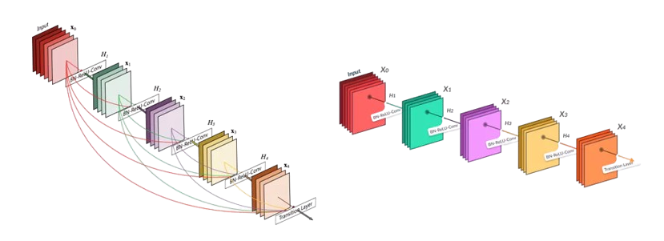
Model 1 - DenseNet128
A custom deep learning model developed using TensorFlow's Keras API. It's designed to detect subtle patterns from input features.
3 Fully Connected Layers – 128, 64, and 32 neurons
ReLU activation functions
Dropout layers for regularization
Sigmoid output for binary classification
Adam optimizer & Binary Crossentropy loss
Trained for 100 epochs, batch size of 32

Slide 6
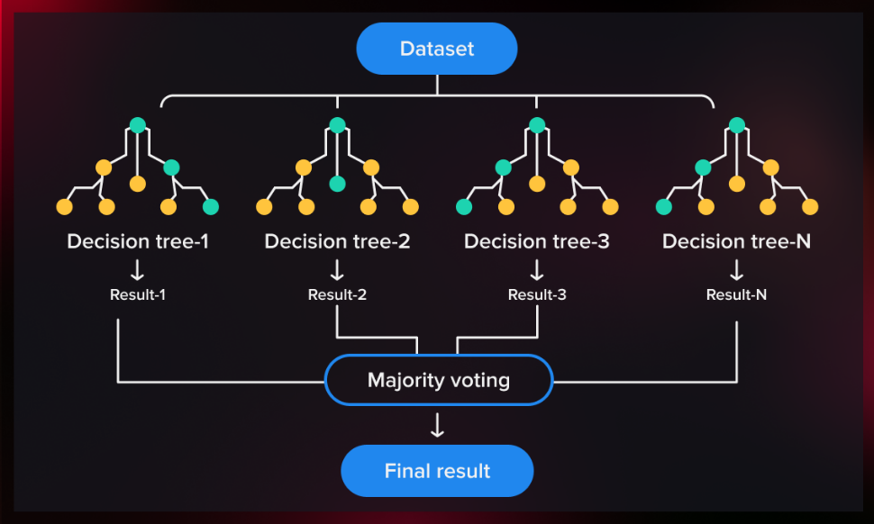
Model 2 - Enhanced Random Forest
A classic machine learning model leveraging the power of ensemble learning.
Used as a baseline model for performance comparison.
200 decision trees
Trained on the same dataset
Saved as '.pkl' using joblib

Slide 7
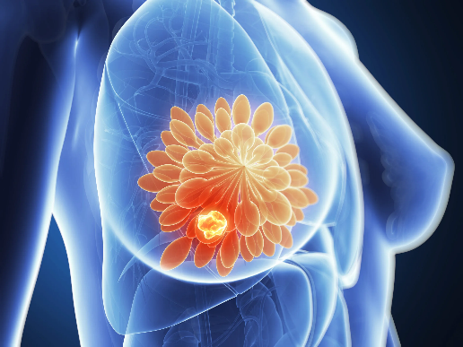
Training and Evaluation
Both models underwent rigorous training and evaluation using standard metrics.
Accuracy – Overall correctness of predictions
Precision – Relevance of positive predictions
Recall – Ability to detect all actual positives
F1 Score – Balanced metric for performance

Slide 8

Frontend: HTML, CSS, JavaScript & Bootstrap
The frontend is built using HTML, CSS, and JavaScript, with Bootstrap for a modern, responsive design. It features:
Clean input forms for patient data entry.
Responsive layout using Bootstrap’s grid system.
Interactive UI with real-time validation via JavaScript.
Custom styling for a professional medical interface.
This user-friendly interface ensures seamless data input and smooth communication with the Flask backend.

Slide 9
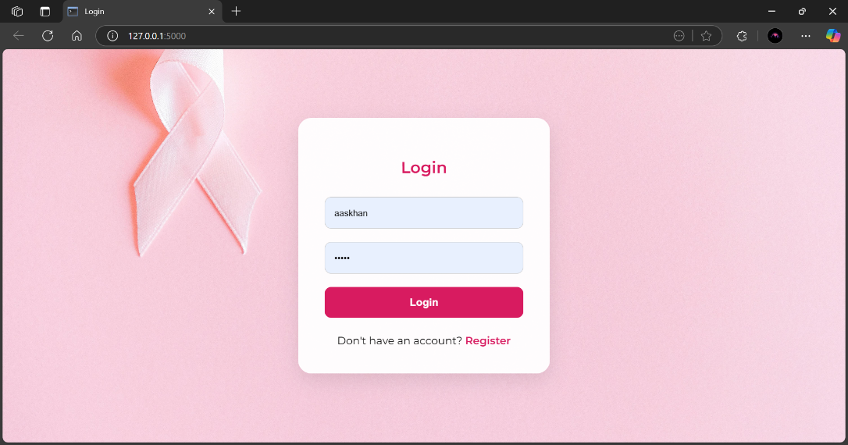
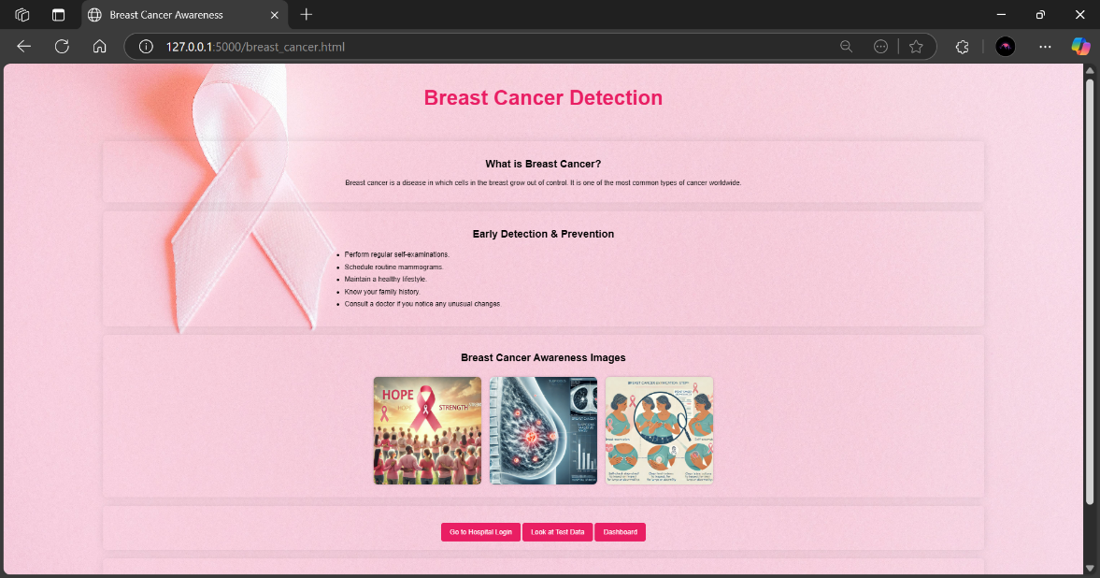
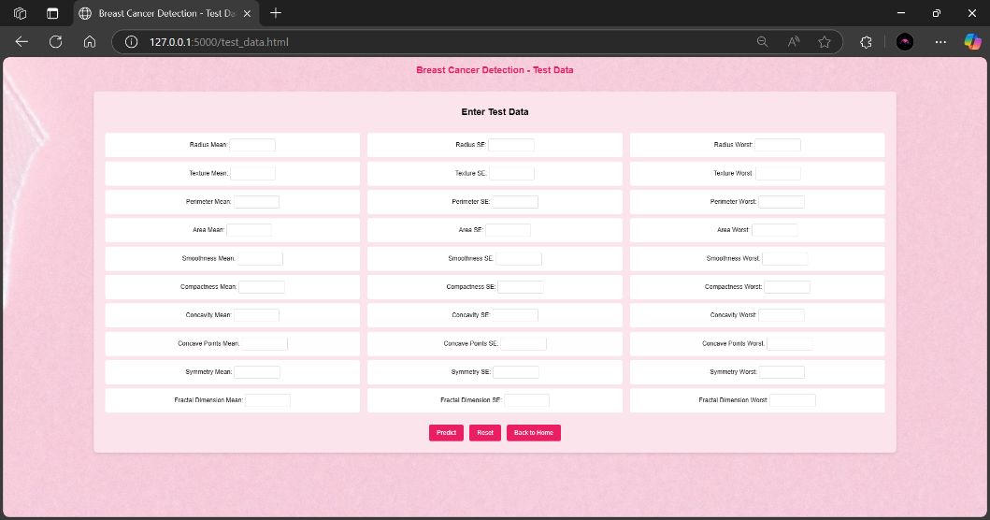

Slide 10



Backend: Flask Integration & SQLite Database
The backend is developed using Flask, a lightweight Python web framework that manages user requests and coordinates with the machine learning models. It performs key tasks like:
Routing and API handling for frontend-backend communication.
Data preprocessing and validation before prediction.
Model loading and prediction in real time.
For data storage, the system uses SQLite, a lightweight relational database:
Stores patient records and prediction logs.
Ensures quick access and easy deployment with no server dependency.
Ideal for small-scale, offline, or prototype environments.
This combination offers a seamless bridge between user input, model inference, and data persistence.

Slide 11
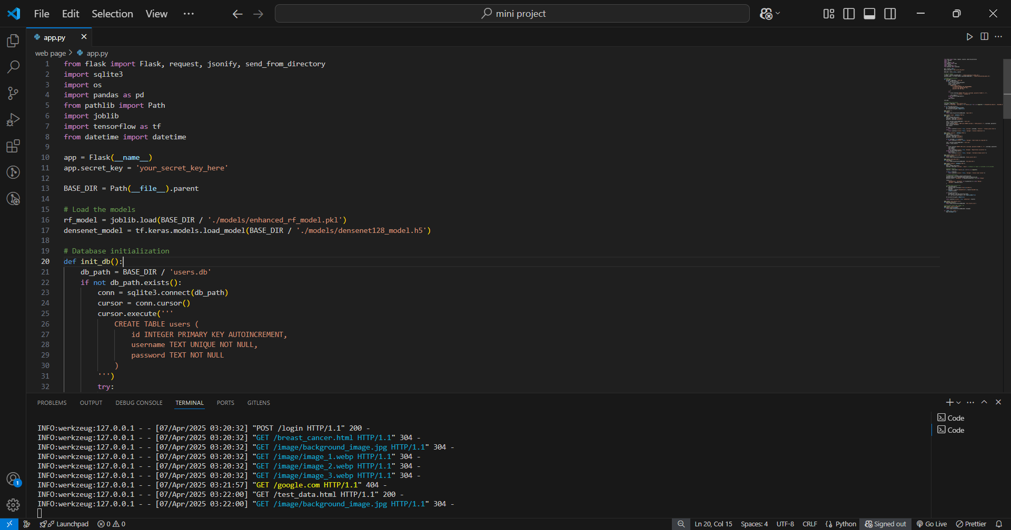
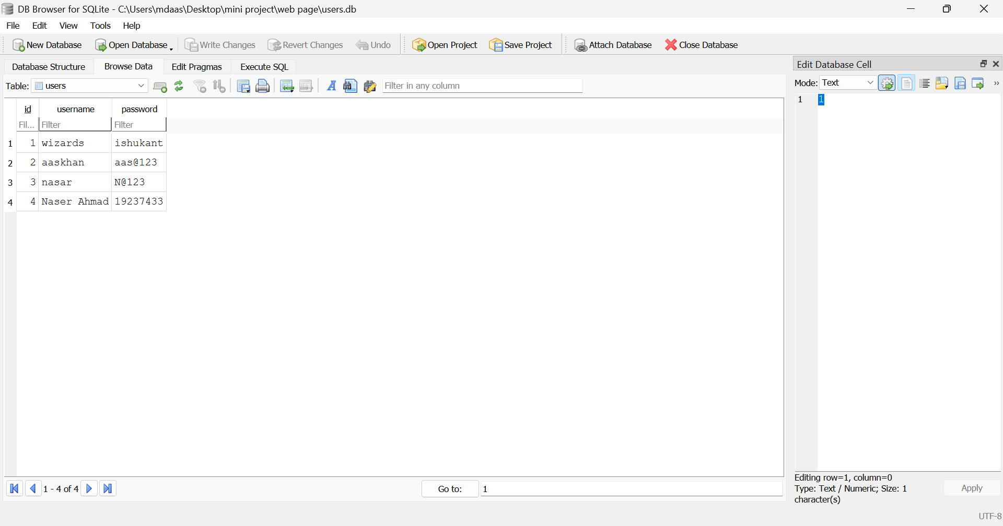

Slide 12
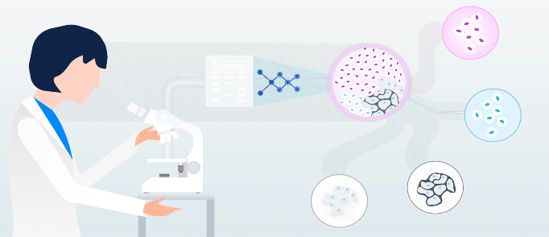
Models: DenseNet128 and Random Forest
The system incorporates two main models: DenseNet128, a deep learning model designed for high accuracy in image-like data, and Enhanced Random Forest, a traditional machine learning model that serves as a performance benchmark.
DenseNet128 is a convolutional neural network architecture that consists of dense blocks, where each layer is connected to every other layer in a feed-forward manner. This promotes feature reuse, leading to improved performance in classification tasks. The architecture uses ReLU activations and dropout layers to prevent overfitting. The model is trained on breast cancer patient data for 100 epochs to optimize its ability to predict outcomes.
The Enhanced Random Forest model is an ensemble learning method that constructs multiple decision trees during training. It utilizes 200 trees to improve prediction accuracy and reduce overfitting. The model is trained on the same dataset as DenseNet128 and evaluated on the same performance metrics, ensuring a fair comparison. Accuracy, precision, recall, and F1 score are used to gauge its effectiveness.

Slide 13
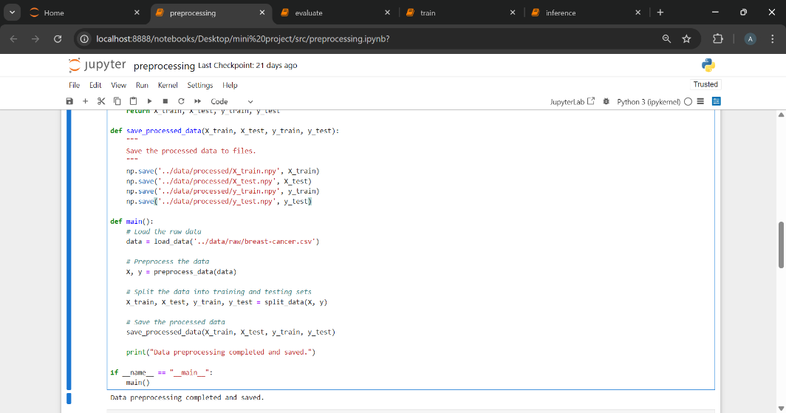
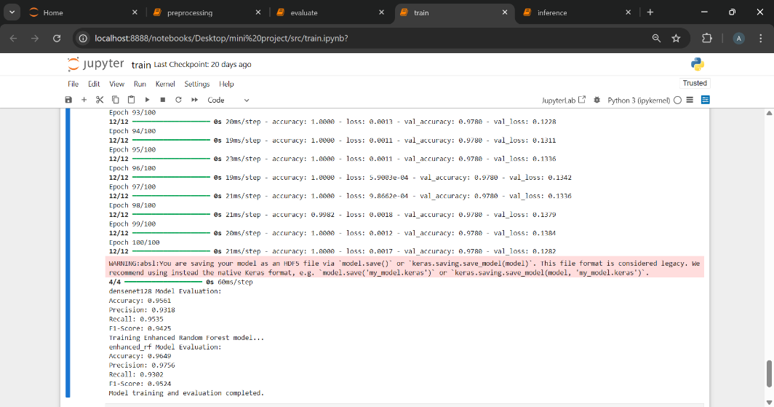
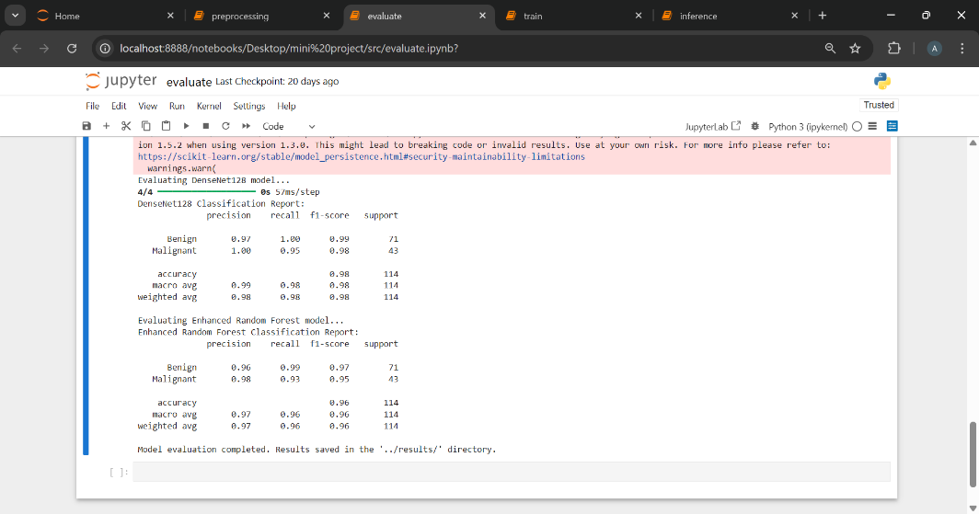

Slide 14
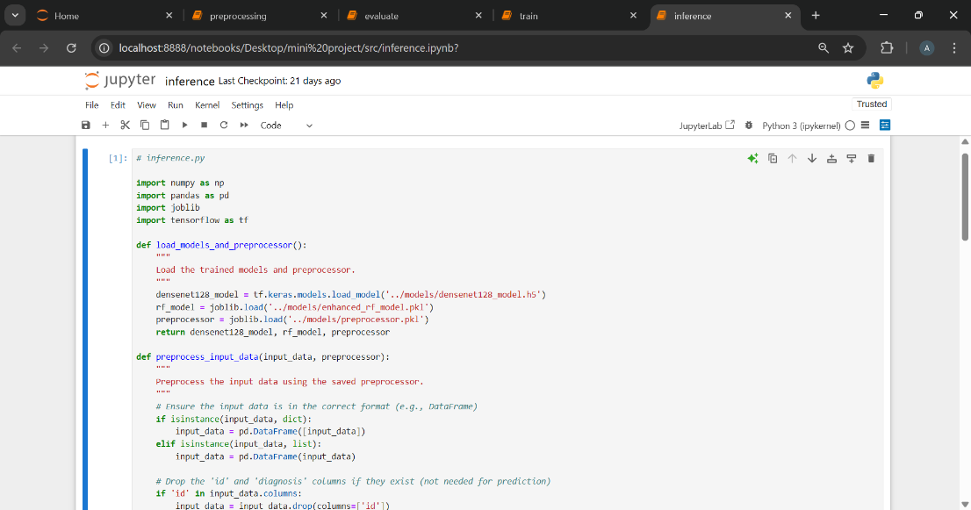
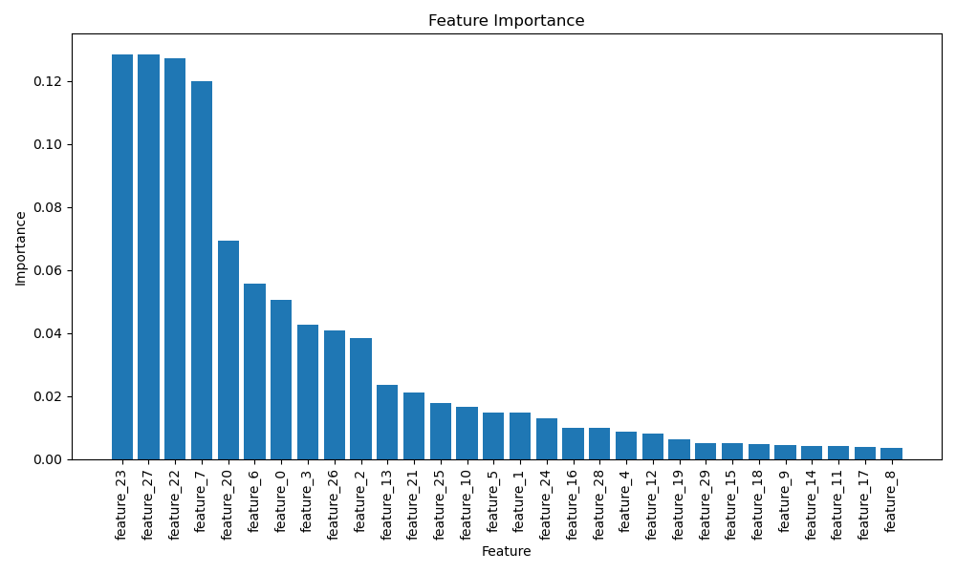
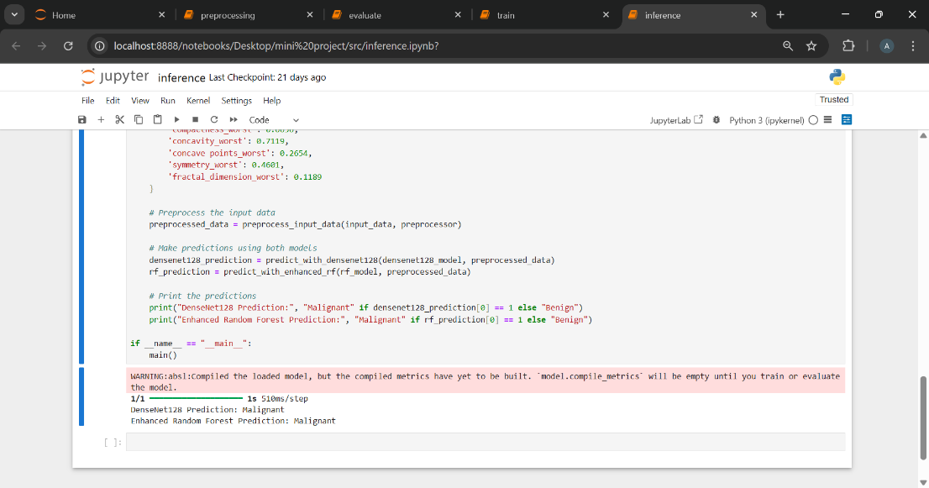

Slide 15
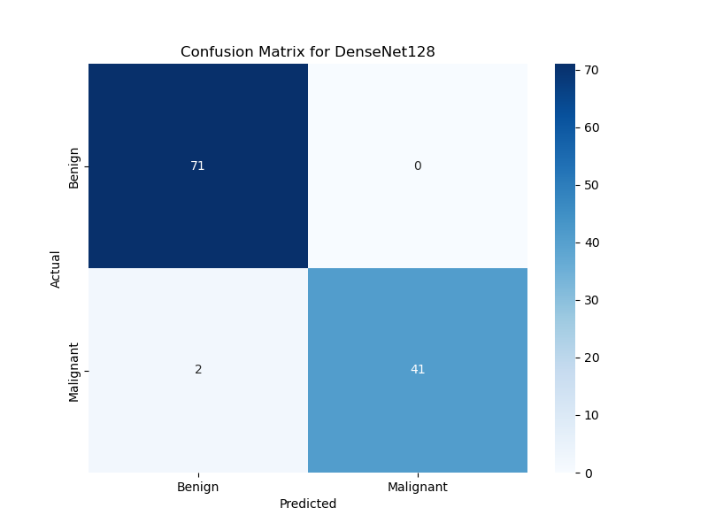
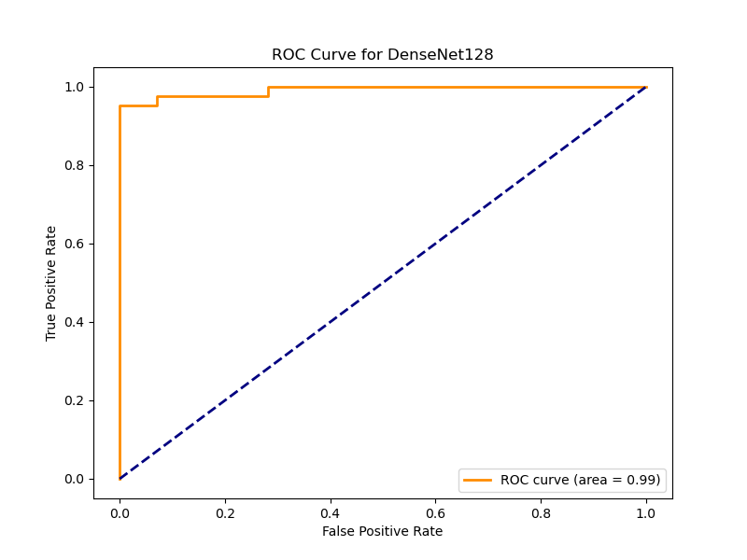
DenseNet128

Slide 16

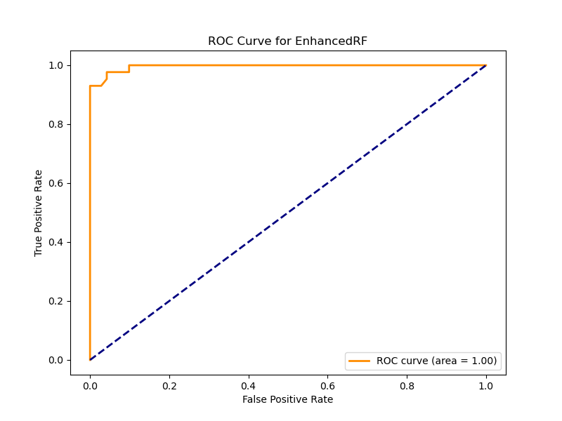
Enhanced Random Forest

Slide 17
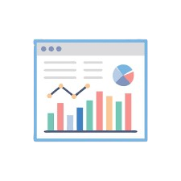


Visualization Dashboard – Power BI
The system integrates Power BI to provide an interactive and insightful visualization dashboard. Key functionalities include:
Real-time data visualization of prediction outcomes and patient trends.
Custom reports and interactive charts for monitoring model performance and diagnostic statistics.
User-friendly interface for easy interpretation and decision-making. Power BI enhances the system by turning complex data into clear, actionable insights, supporting better understanding and clinical use.

Slide 18
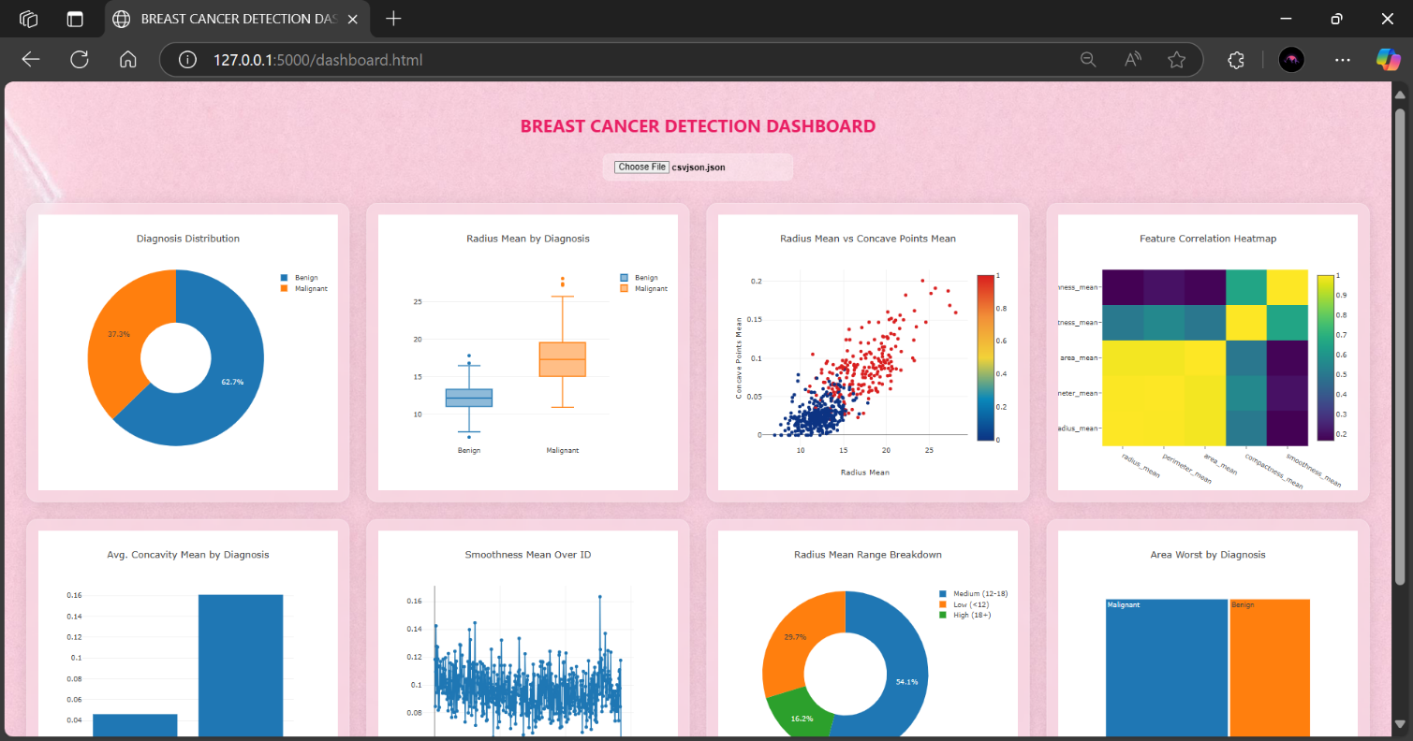
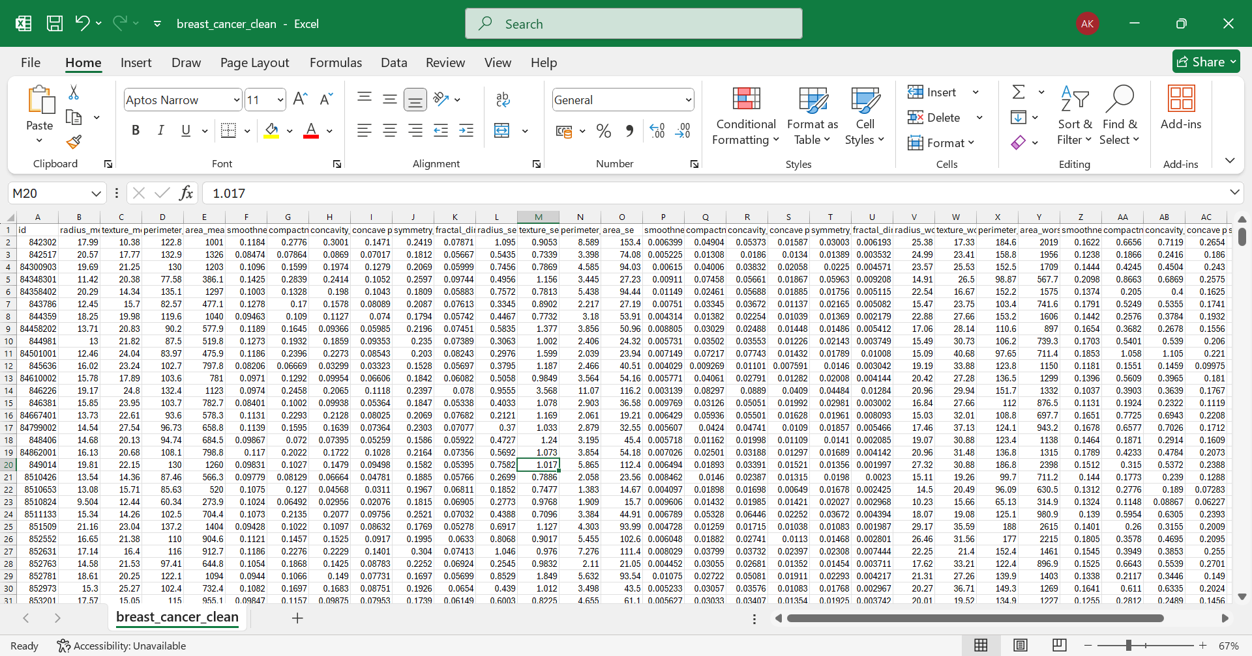

Slide 19
Results
The DenseNet128 model demonstrated superior performance across all evaluation metrics, showcasing high accuracy, precision, and recall. In comparison, the Enhanced Random Forest model, while delivering solid results, slightly lagged behind in precision and recall. These findings highlight the potential of deep learning models like DenseNet128 to outperform traditional machine learning approaches in medical prediction tasks, affirming their effectiveness and reliability.
Challenges Faced
Throughout the development process, several challenges were encountered. Overfitting in the deep learning model was a key issue, addressed through the use of Dropout techniques. Ensuring seamless integration between the frontend and backend required careful routing via Flask. Additionally, optimizing dataset preprocessing demanded precise tuning to enhance model performance. Despite these hurdles, the final system delivered robust and reliable results, reinforcing its value in medical diagnostic applications.

Slide 20
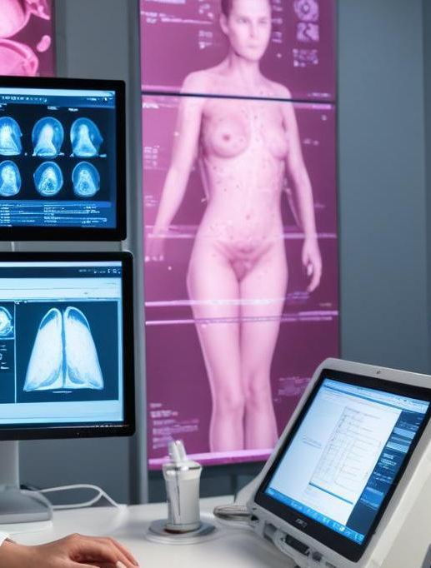
Conclusion
This project presents a robust, MI-powered web application for early breast cancer detection, combining deep learning with user-friendly web integration. It empowers healthcare professionals with fast, accurate, and informed decision support. The successful fusion of advanced prediction models and intuitive interfaces highlights the potential of MI in medical diagnostics. Looking ahead, enhancements like model explainability and image-based analysis will further strengthen its clinical value and impact.

Slide 21

Thank you!
Do you have any questions?

